Slide 1

Subject : LINUX PATCH MANAGEMENT
Presented By : IDC TEAM
IDC
IDC - Planning, Engineering & Implementation

Slide 2
REDHAT PATCH MANAGEMENT
1. For RHEL Patch management requires 3 servers/VMs.
2. One primary server which is internet facing for downloading latest packages/patches from Redhat Network
3. 2NOs secondary servers for YUM repository which will be synced periodically from the primary server.
4. Clients can update patches/packages from secondary patch management servers.
5. Clients load can distributed between the two secondary servers by load balancer.
6. For RHEL PATCH management https protocol used which is able to handle 500 connections per server.
7. Considering 4 Yrs estimation proposed partition size for patch downloading will be 500GB.
8. Same architecture will be used for the RHEL6
IDC

Slide 3
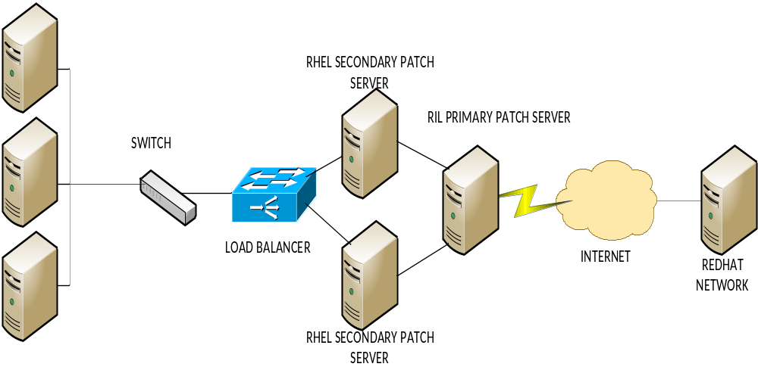
RHEL PATCH SERVER ARCHITECTURE
IDC

Slide 4
1. For Spacewalk Patch management requires 3 servers/VMs.
2. One primary server which is internet facing for downloading latest packages/patches from
Spacewalk Network.
3. 2 NOs Spacewalk servers which will be synced periodically from primary server.
4. Clients can update patches/packages from Spacewalk servers.
5. Clients load can distributed between the two secondary servers by load balancer.
6. For Spacewalk PATCH management https protocol used which is able to handle 500 connections per server.
7. Considering 4 Yrs estimation proposed partition size for patch downloading will be 500GB.
IDC

Slide 5
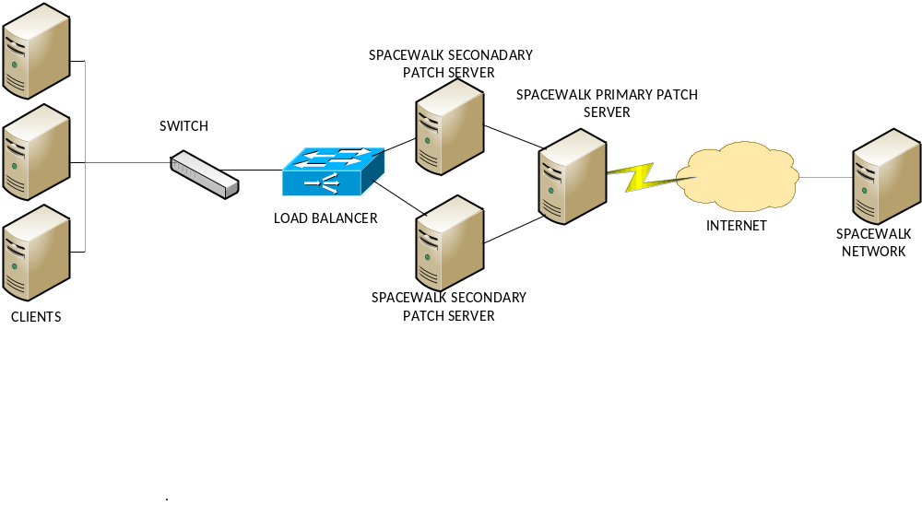
IDC

